Slide 1
A city side view
A beautiful city side view

Slide 2
Functions and explanation
We are the group 5 member, here we will try to explain about our project with different kind of function
We used animation in car, plan, cloud, boat using as followings “void car(); void plan(); void cloud(); void boat()”.
We used multiple car, plan, cloud and boat using glTranslatef();
We used boat_move(); car_run(); function to animate certain object.
The other non animated obj are also used glTranslatef(); for increasing the number of object.

Slide 3
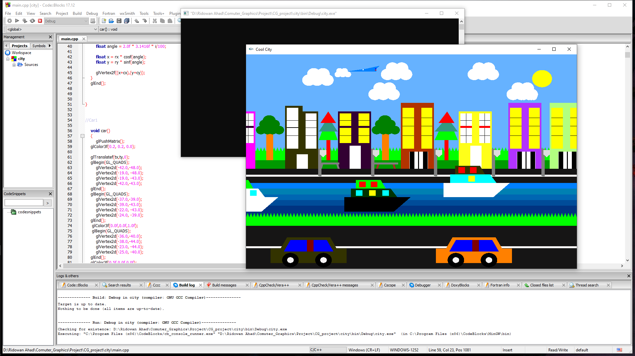
Here is day view of the project

Slide 4
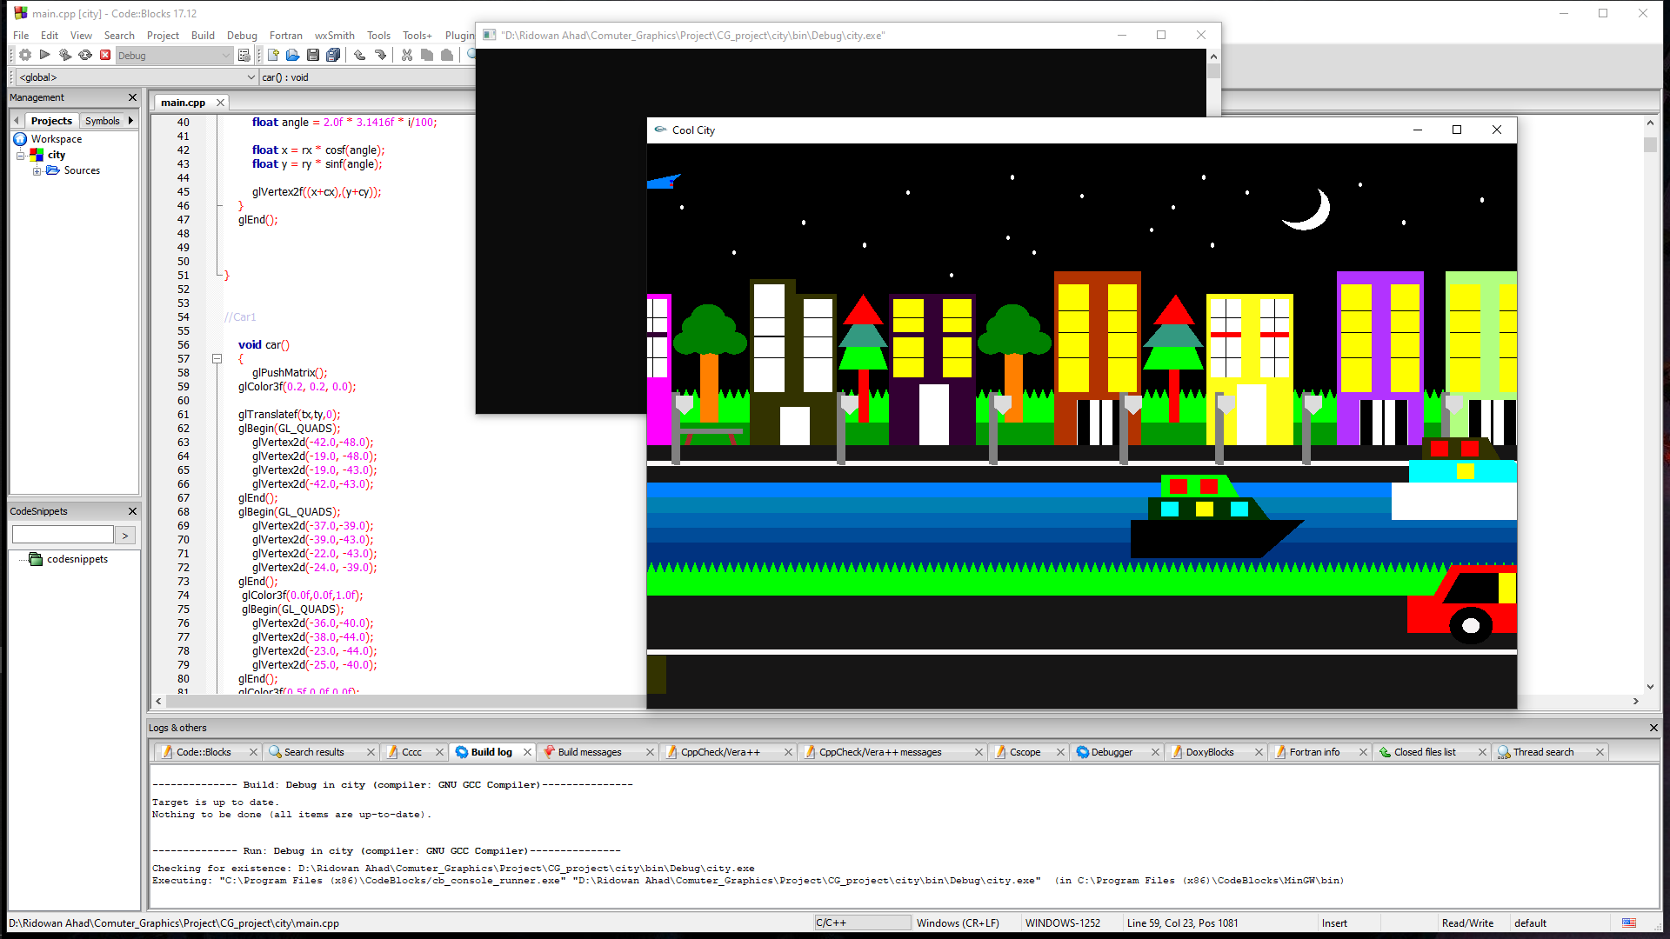
Here is night view of the project

Slide 5
Thank you
sir

